Slide 1

Financial Engine using Python and Time-Series
By manraj Singh mokha

Slide 2
Abstract
Introduction
Objectives
Implementation
Hardware and Software
Proposed Methodology
Results
Conclusion
Future scope
References
INDEX

Slide 3
This project presents an innovative approach to stock price prediction by integrating the powerful time series forecasting tool, Prophet, with advanced time series analysis techniques. The primary focus is on developing a robust predictive model to anticipate future stock prices and trends. Leveraging the flexibility of Prophet, we incorporate its capabilities for capturing complex seasonal patterns and handling multiple seasonality components. The objective of this application is to create a stock predictor app using web scraped data(historical) to predict future stock closing price. The Prediction is done using FaceBook's Prophet and the web application has been created using Streamlit. In conclusion, this project showcases a comprehensive approach to stock price prediction, leveraging the strengths of Prophet, time series analysis, and Streamlit. The combination of these tools provides a powerful framework for both researchers and investors seeking informed insights into future stock market trends
ABSTRACT

Slide 4
In response to the imperative nature of stock price prediction in financial markets, this project introduces a Stock Predictor application. The project leverages the capabilities of yfinance, a Python library specialized in importing financial data, to ensure the acquisition of accurate and comprehensive historical stock information. The predictive modeling aspect is handled by Facebook's Prophet, a potent time series forecasting tool, with the resultant application crafted for user-friendly interaction through the Streamlit framework. By utilizing yfinance, the project ensures a robust foundation of historical stock data. This sets the stage for accurate predictions by providing the Prophet model with relevant and high-quality input. Prophet, known for its adaptability to various time series patterns, is employed to model historical stock data and forecast future closing prices. Its ability to handle seasonality and incorporate user-defined inputs makes it well-suited for the intricacies of stock price prediction. The integration of Streamlit transforms the predictive model into an accessible web application. Users can effortlessly explore historical trends, adjust parameters, and visualize predicted stock closing prices in real-time, creating an engaging and informative user experience. This report will delve into the project's methodology, challenges faced, and outcomes achieved, highlighting the collaborative synergy between yfinance, Prophet, and Streamlit in creating a comprehensive and user-friendly solution for stock price prediction. The goal is to empower users with a tool that facilitates informed decision-making in the dynamic landscape of financial markets.
INTRODUCTION

Slide 5
The objective of this application is to create a stock predictor app using web scraped data(historical) to predict future stock closing price. The Prediction is done using FaceBook's Prophet and the web application has been created using Streamlit.
OBJECTIVE

Slide 6
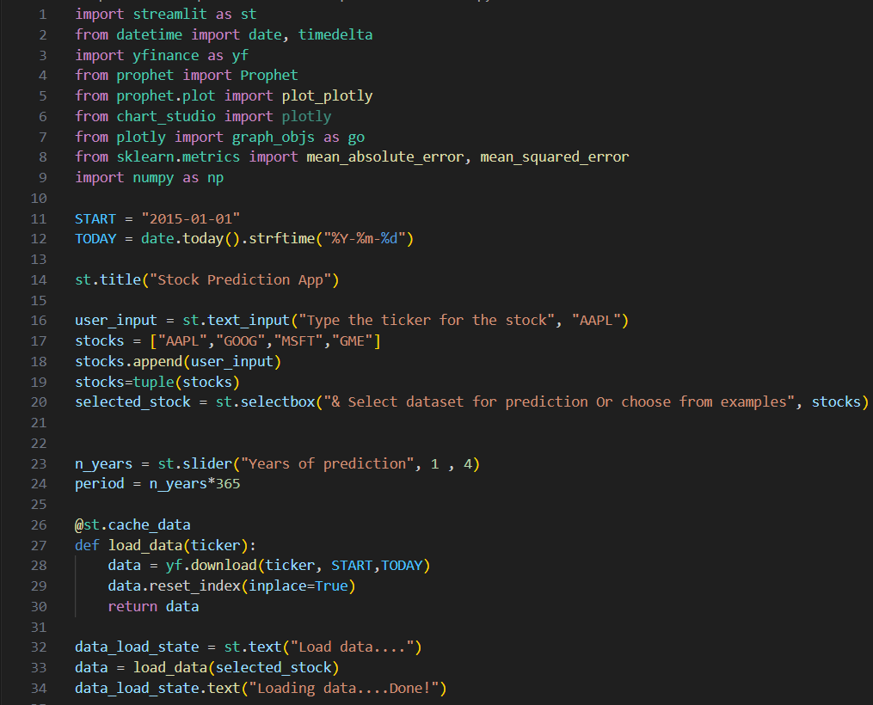
IMPLEMENTATION

Slide 7
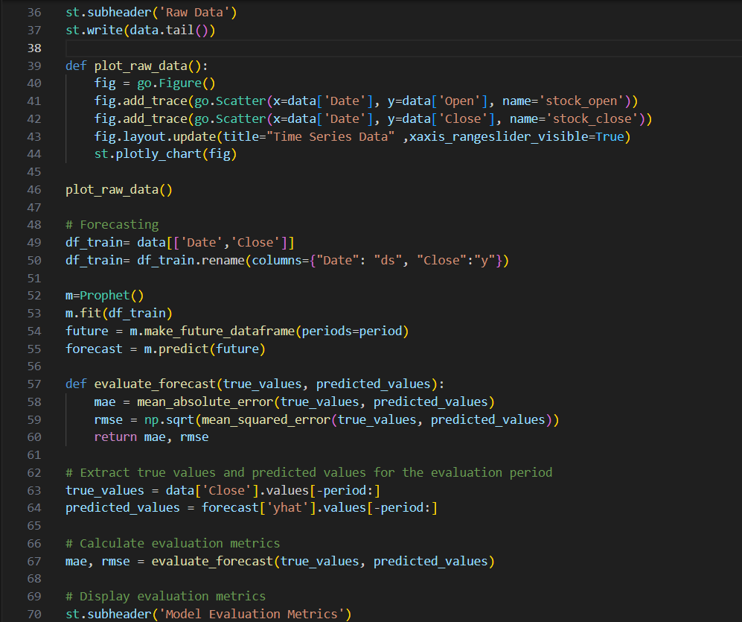
IMPLEMENTATION

Slide 8
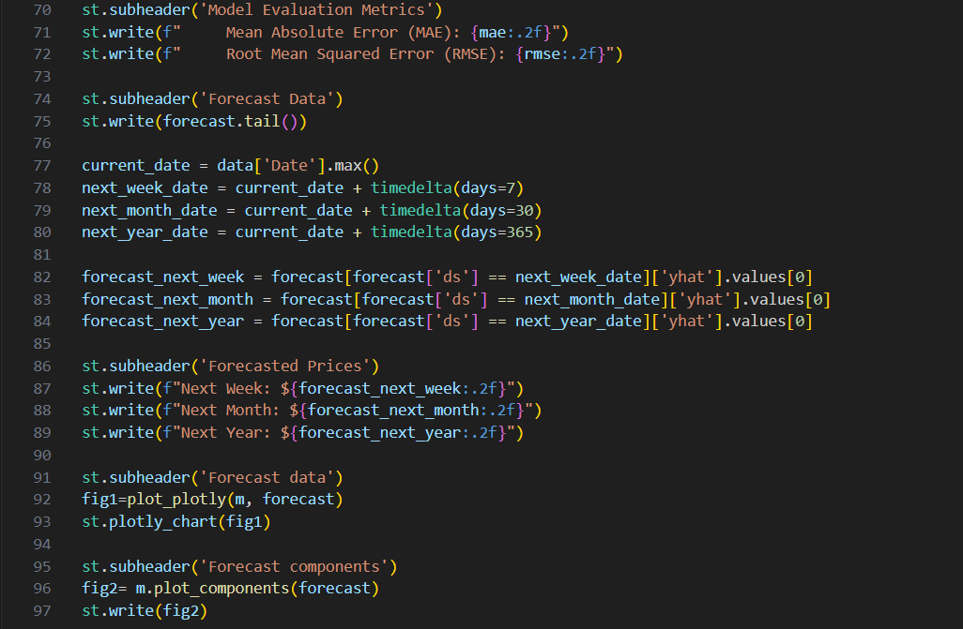
IMPLEMENTATION

Slide 9
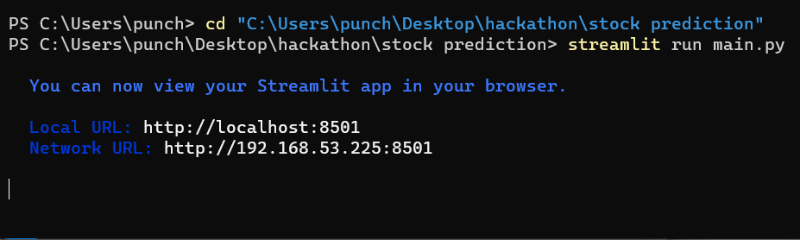
Server Initialization using Terminal:
IMPLEMENTATION

Slide 10
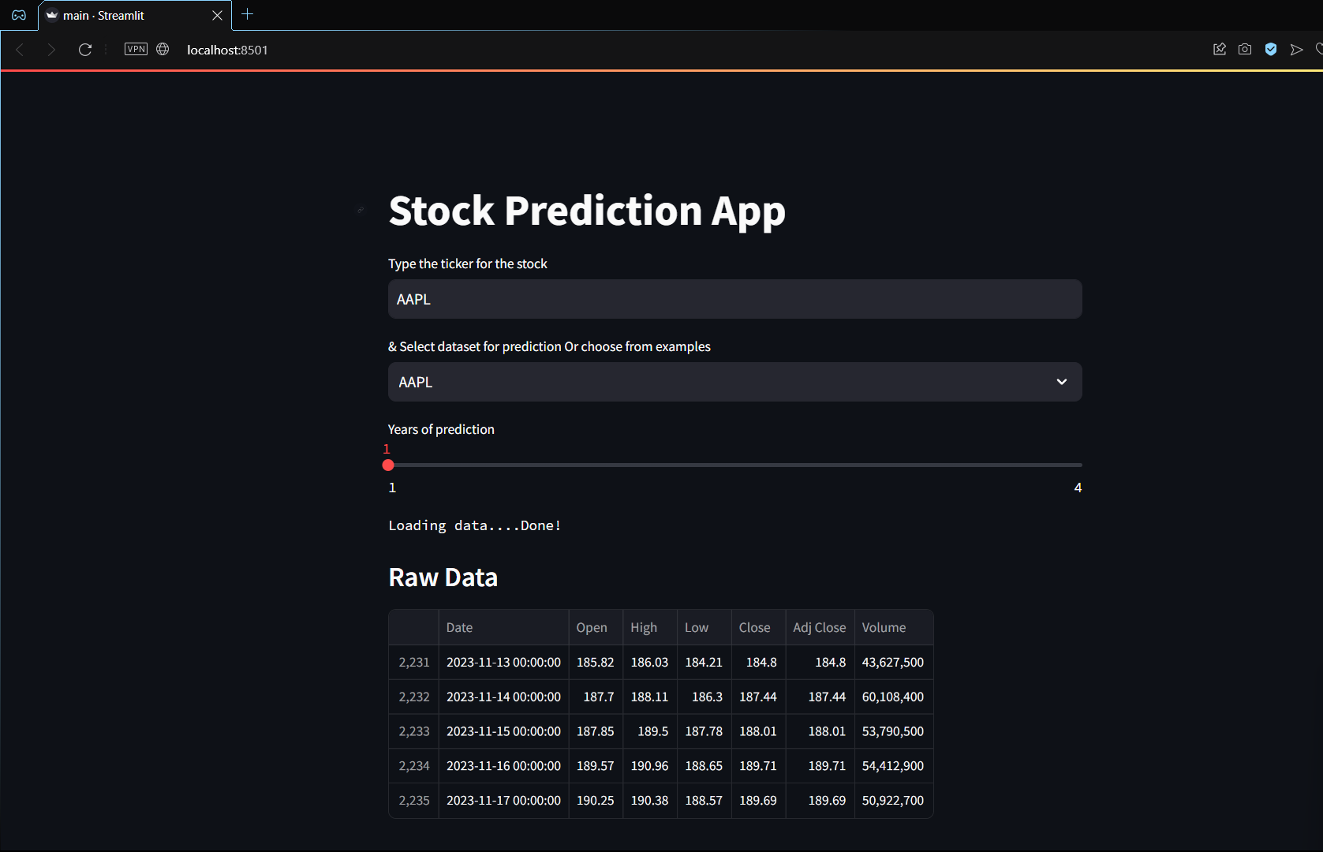
INTERFACE
IMPLEMENTATION

Slide 11
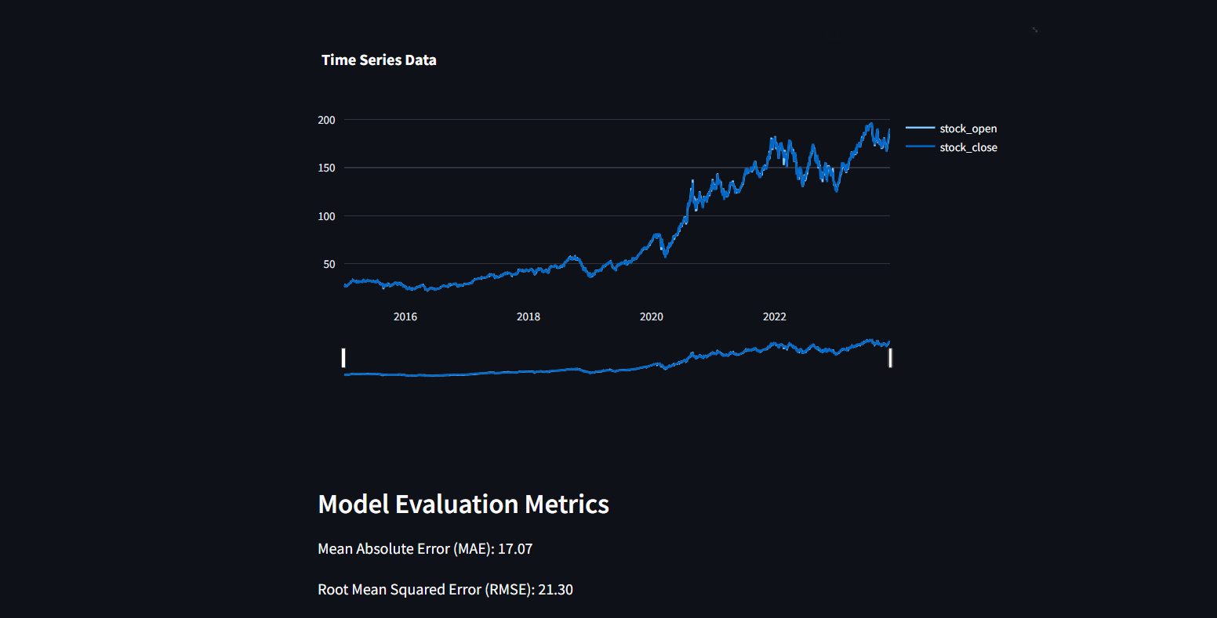
IMPLEMENTATION

Slide 12
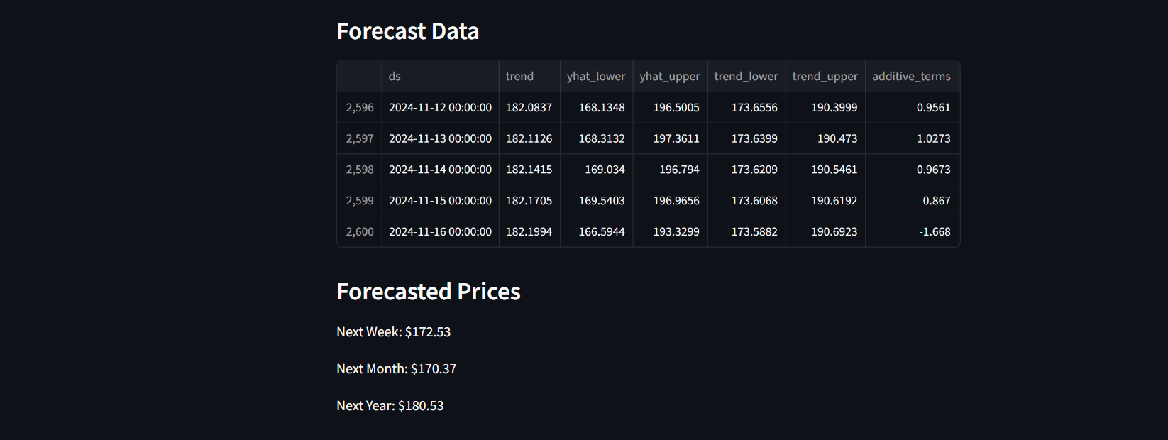
IMPLEMENTATION

Slide 13
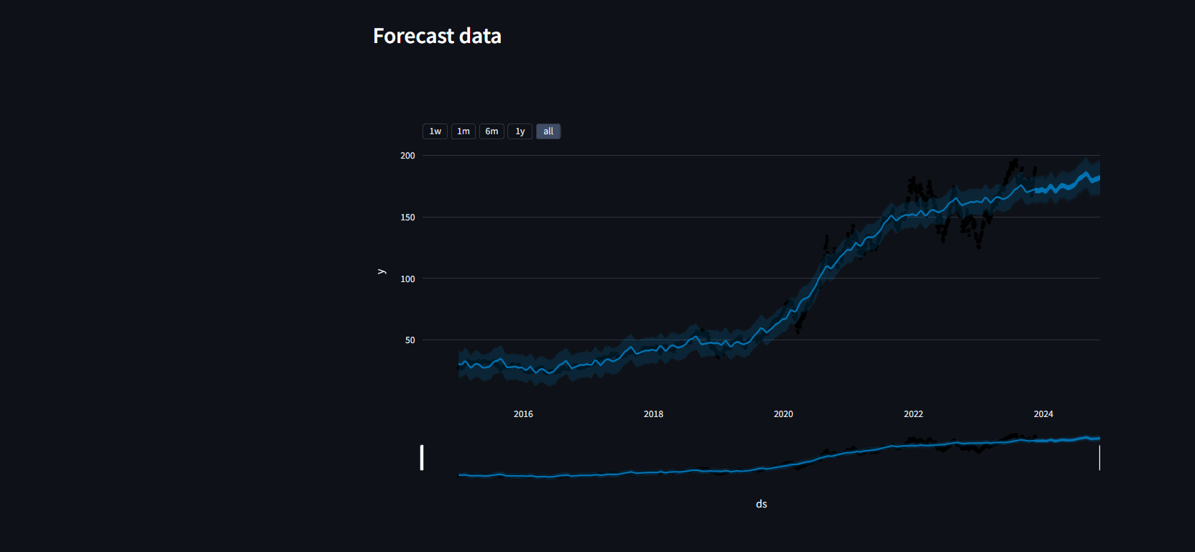
IMPLEMENTATION

Slide 14
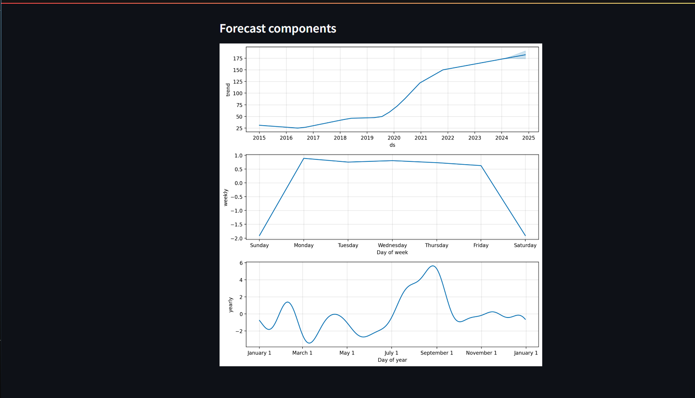
IMPLEMENTATION

Slide 15
HARDWARE REQUIREMENTS:
1. Computing Power:
  A multi-core processor for data processing and model training.
  Sufficient RAM for handling large datasets and complex machine learning models.
2. Storage:
  Adequate storage space for storing datasets, model parameters, and results.
  SSDs are recommended for faster data access.
3.Network:
  High-speed internet access, especially if you need to access cloud resources or download large datasets.
4.Cloud Computing:
  Cloud platform for scalability and access to specialized hardware for machine learning tasks.
Hardware and Software

Slide 16
SOFTWARE REQUIREMENTS:
1. Operating System:
  Linux-based systems are commonly used for machine learning projects due to their stability and developer-friendly environment.
  However, Windows and macOS are also suitable.
2. Programming Languages:
  Python is the most popular language for machine learning and data science.
3. Development Environment:
  Integrated Development Environments (IDEs) like PyCharm, Visual Studio Code, or Google collab for coding and project management and for interactive development and data exploration.
4. Machine Learning Libraries:
  Key libraries include Prophet, Streamlit and Chart-Plotly for data manipulation and machine learning model development.
5. Model Deployment:
  Frameworks like Cloud-based services for deploying and serving predictive models.
6.Security:
  Ensure data security and compliance with relevant financial and social data protection regulations.
Hardware and Software

Slide 17
Data Collection:
Utilize the Yfinance library to import historical stock data for the selected ticker. Ensure the dataset includes relevant information such as date, opening price, closing price, high, low, and volume.
Proposed Methodology
Request Data using Yfinance module
Yahoo! website sends back the data according to our criterias
change the format for the upload
Upload the dataset into the module for forecasting
Figure 1: Data Preprocessing

Slide 18
Table 1: Sample Dataset of CRUDE OIL
Sno. | Date | Open | High | Low | Close | Adj Close | Volume
2231 | 2023-11-13T00:00:00.000 | 185.82 | 186.03 | 184.21 | 184.8 | 184.8 | 43627500
2232 | 2023-11-14T00:00:00.000 | 187.7 | 188.11 | 186.3 | 187.44 | 187.44 | 60108400
2233 | 2023-11-15T00:00:00.000 | 187.85 | 189.5 | 187.78 | 188.01 | 188.01 | 53790500
2234 | 2023-11-16T00:00:00.000 | 189.57 | 190.96 | 188.65 | 189.71 | 189.71 | 54412900
2235 | 2023-11-17T00:00:00.000 | 190.25 | 190.38 | 188.57 | 189.69 | 189.69 | 50922700
OBJECTIVE

Slide 19
Encode the data
Split the data
Train
30%, test 70%
Train
model
Make predictions
Evaluate the model
Decode
Figure 2: Machine Learning Algorithm of any ML model (here Prophet)
Exploratory Data Analysis (EDA):
Perform EDA on the imported data to understand its structure, identify trends, and check for missing values or outliers. Visualize key metrics, such as stock closing prices, to gain insights into the underlying patterns.
Data Preprocessing:
Handle missing values, outliers, and any data anomalies. Convert the date column to the required format. Prepare the data for input into the forecasting model.
Proposed Methodology

Slide 20
Time Series Forecasting Model Selection:
Choose Facebook's Prophet as the time series forecasting model due to its ability to handle seasonality, flexibility, and user-friendly interface. This model is well-suited for capturing the complex patterns inherent in financial time series data.
Data Splitting:
Split the historical data into training and testing sets. The training set will be used to train the Prophet model, while the testing set will be reserved for evaluating the model's accuracy.
Model Training:
  Train the Prophet model using the training set. Adjust model parameters as needed, considering factors such as seasonality strength, trend flexibility, and changepoints.
Proposed Methodology

Slide 21
Model Evaluation:
  Evaluate the model's accuracy using metrics like Mean Absolute Error (MAE) and Root Mean Squared Error (RMSE). Assess how well the model performs on the testing set, ensuring it generalizes to new data.
Web Application Development:
  Utilize Streamlit to create an interactive and user-friendly web application. Design an interface that allows users to input the stock ticker, select the prediction horizon (e.g., next week, month, year), and visualize the forecasted prices.
Real-time Prediction:
  Implement functionality to dynamically generate real-time predictions based on user input. Allow users to explore historical trends and visualize forecasted prices for different time horizons.
Proposed Methodology

Slide 22
User Feedback and Iteration:
Gather user feedback on the web application's usability and functionality. Iterate on the design and features based on user suggestions to enhance the overall user experience.
Documentation and Reporting:
Document the entire process, including data preprocessing steps, model training details, and web application development. Prepare a comprehensive report outlining the methodology, challenges faced, and results obtained.
Deployment:
Deploy the web application to a suitable hosting platform, making it accessible to users. Ensure the application is scalable and can handle a reasonable number of concurrent users.
Proposed Methodology

Slide 23
• Continuous Improvement:
Monitor the model's performance over time. Consider periodic updates to the model using new historical data for improved forecasting accuracy.
By following this proposed methodology, you can systematically approach the development of your stock prediction application, combining the strengths of Prophet, yfinance, and Streamlit for a comprehensive and user-friendly solution.
Proposed Methodology

Slide 24
Proposed Methodology
Table 2: Tabular Representation of the output

Slide 25
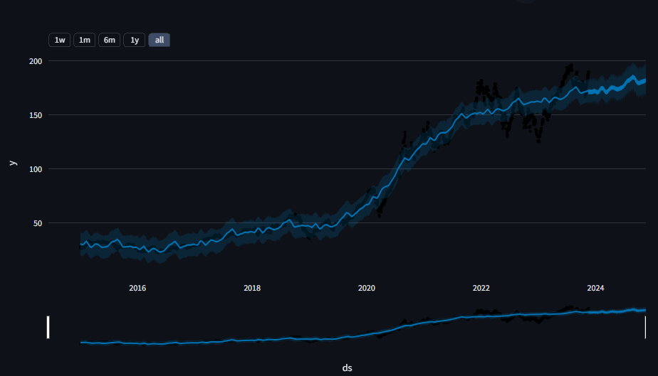
RESULTS

Slide 26
Forecasted Prices:
• Next Week: $172.53
• Next Month: $170.37
• Next Year: $180.53
Model Performance Analysis:
Evaluation metrics such as Mean Absolute Error (MAE) and Root Mean Squared Error (RMSE) are employed to assess the accuracy and reliability of the developed model.
Mean Absolute Error (MAE): 17.07
Root Mean Squared Error (RMSE): 21.30
RESULTS

Slide 27
Conclusion:
We have successfully made a working prototype for a single module stock price predictor with a working frontend and backend.
Future Scope:
Addition of Indian Holidays to ensure better prediction.
Inclusion of External data like weather data or macroeconomic variables, etc which might impact the closing price.
CONCLUSION
& FUTURE SCOPE

Slide 28
https://facebook.github.io/prophet/
https://streamlit.io
https://www.google.com/url?sa=t&rct=j&q=&esrc=s&source=web&cd=&cad=rja&uact=8&ved=2ahUKEwjM66XZo9OCAxXqSWwGHSYyBQMQFnoECBIQAQ&url=https%3A%2F%2Ffinance.yahoo.com%2F&usg=AOvVaw0bxvLbv9KsKdEl7v53X0W-&opi=89978449
https://plotly.com/python/getting-started-with-chart-studio/
References

